Slide 1
Failure to Thrive May 5, 2024 University of Ottawa, MED2 Unit IV
Eva Ouyang, MD, FRCPC
Pediatrician
Division of Pediatric Medicine
Children’s Hospital of Eastern Ontario
Slides originally developed by Dr. Anne Rowan-Legg

Slide 2
Conflict of Interest
I have no conflict of interest to declare

Slide 3
Social Media Disclosure
You may only access and use this PowerPoint presentation for educational purposes. You may not post this presentation online or distribute it without the permission of the author.

Slide 4
Objectives
Define “failure to thrive” (FTT).
Discuss the differential diagnosis for FTT in children.
Outline an appropriate history in a child with FTT.
Recognize the role of the multidisciplinary team in the management of FTT in children.

Slide 5
Objectives
Define “failure to thrive” (FTT).
Outline an appropriate history in a child with FTT.
Discuss the differential diagnosis for FTT in children.
Recognize the role of the multidisciplinary team in the management of FTT in children.

Slide 6
FTT - Description
Clinical syndrome of inadequate growth
Failure to gain weight appropriately
In more severe cases, linear growth and head circumference affected
FTT is a descriptive term, not a diagnosis
Underlying cause must be considered
Now often being replaced with “growth faltering,” or ”poor weight gain”
Notes:
Growth faltering is being used more in the literature as it’s more descriptive and less pejorative

Slide 7
Epidemiology
Common problem
Prevalence <2% to >10% (due to definition differences)
More prevalent among children in low-income households, with special health-care needs, of refugee status, born at lower birth weight
Tang et al. Pediatr Rev 2021.
Important cause of stress for families
Long term consequences
Increased incidence of developmental delays, learning and/or behavioural difficulties, nutrient deficiencies, persistent short stature
Notes:
“If an underlying condition is detected early, treated appropriately and the child is provided with adequate nutrition, growth failure may be reversible. If not, the child’s ultimate height may be affected. The potential for catch-up growth depends on severity, duration and timing of the insult.”

Slide 8
Growth Charts
CDC (Centre for Disease Control)
WHO (World Health Organization)
CPEG (Canadian Pediatric Endocrine Group)
Take home points:
Use the WHO Growth Charts for Canada (March 2014 revision)
Prefer Set 2 (3/10/25/50/75/90/97 centiles) over Set 1 (3/15/50/85/97 centiles) Marchand, Paediatr Child Health 2010
Special populations (e.g. genetic syndromes like Down syndrome, Turner syndrome) have modified growth charts
Use Fenton preterm growth charts for premature infants <37wk GA (from 22wk GA to 10 wks CGA)
Notes:
CDC
- Published in 2000.
US children. 50% were breasted
Growth references – described how a sample population of children grew, regardless of whether their rate of growth was optimal
WHO - recommended by CPS, College of Family physicians of Canada, Dieticians of Canada, Community Health Nurses of Canada, and Canadian Pediatric Endocrine Group
2006 Child growth standard charts for birth - 5yo:
Designed to reflect growth under optimal conditions
Breastfed population in 6 different countries (Brazil, Ghana, India, Norway, Oman, USA)
Breastfed infants grow more quickly than non-breastfed infants in first 6mo, grow more slowly in second 6mo. Therefore on the CDC graph, breastfed infants look like they’re growing more quickly in first 6mo, then failing to grow sufficiently in later 6mo. On WHO, higher rates of children classified as FTT in first 6mo, higher rates of children classified as overwt + obese after that time.
Does not include prem or VLBW (<1500g), use Fenton preterm growth from 22wk GA to 10wks CGA.
2007 Reference growth charts for 5-19yo. Updated to address the obesity epidemic, so are now closer to growth standards (overwt 85-97%tile BMI for age, obesity >97%tile)
2010: For >10yo, they removed the weight for age guidelines b/c they did not recommend tracking weight alone, but rather BMI due to variable age of puberty.
2014: Removed 0.1%tile to prevent people from thinking that 0.1-3%tile was normal. The 99.9%tile line is now a dashed lined. Included the weight for age for >10yo as dashed lines. Released two sets with different percentiles displayed
- In 2010, WHO growth Chart for Canada released. Updated in March 2014, reviewed again in 2019.
CPEG charts
were designed to address shortcomings in the 2010 WHO Growth Charts Adapted for Canada
CPEG now endorses WHO growth charts because they believe it is important to use a single source for growth charts nationally. Preference for Set 2 (3/10/25/50/75/90/97 centiles) over Set 1 (3/15/50/85/97)
Genetic syndrome charts - caveat that these growth charts may be based on data that included children who were malnourished secondary to medical complications or suboptimal nutritional management of their syndromes.
Fenton growth chart for pre- term infants can facilitate smooth transition to the WHO standards 4 to 10 weeks after term

Slide 9
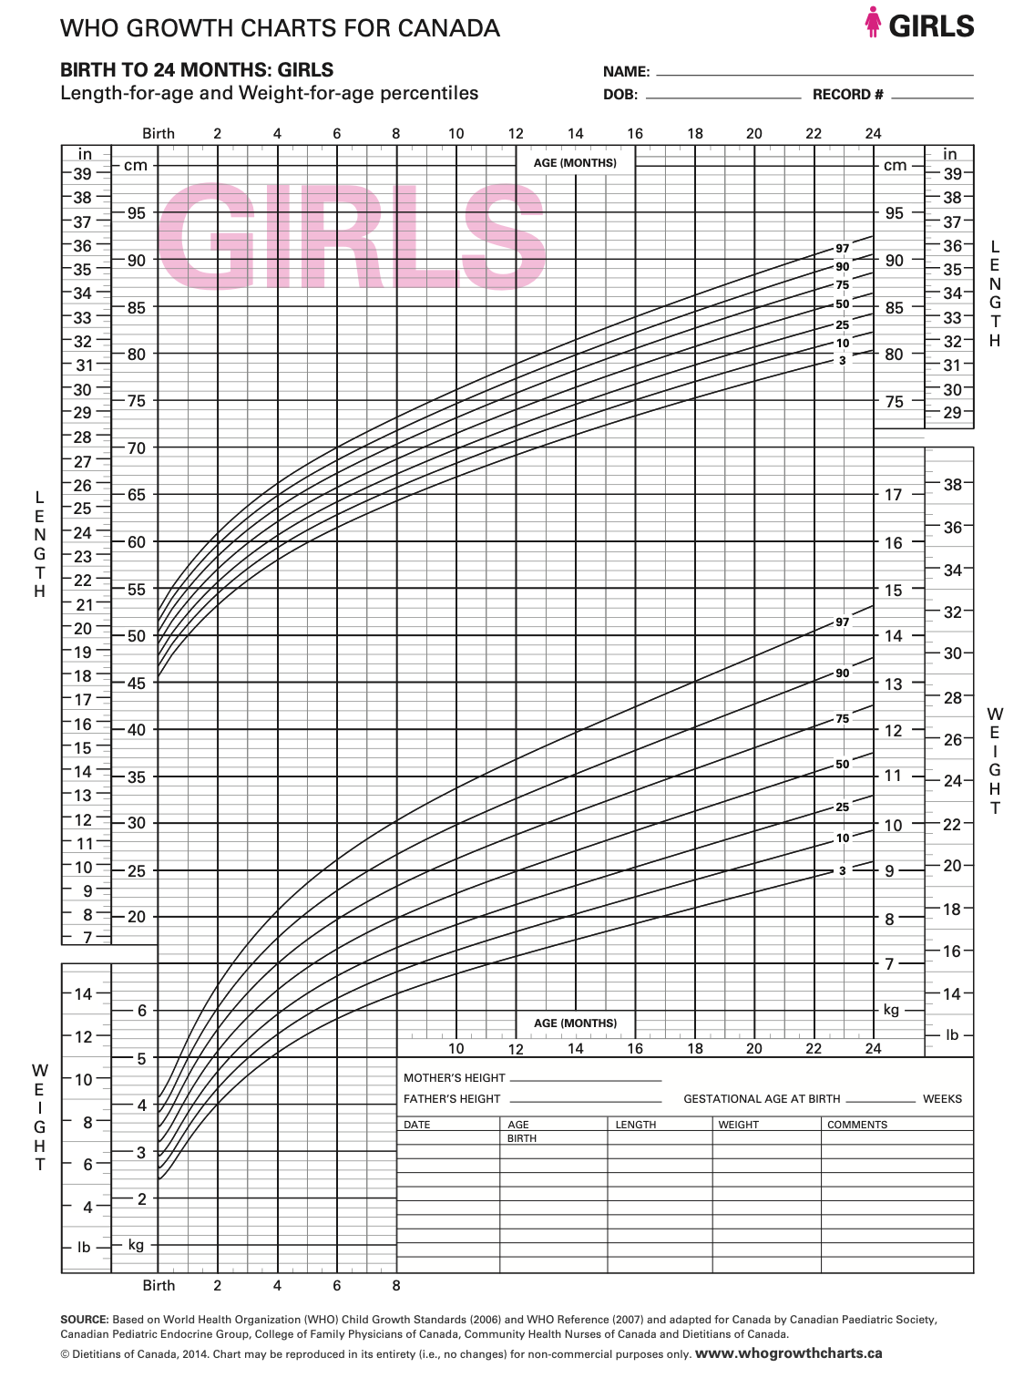
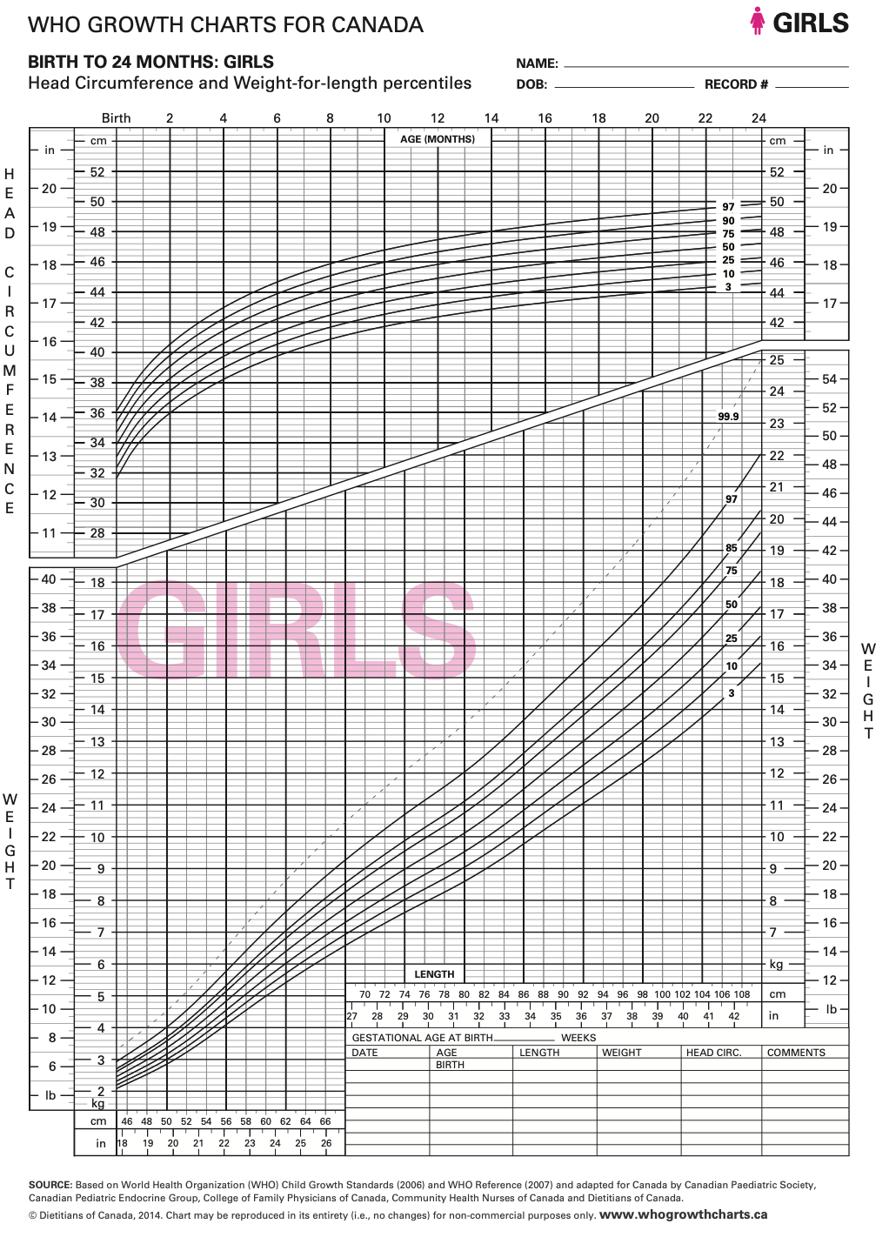

Slide 10
FTT - Definition
No universal consensus
Weight-for-age <3rd percentile
Weight-for-length <3rd percentile
Weight-for-age crosses 2 major percentile lines over time
Weight <80% ideal body weight-for-age
Notes:
During the first 2-3Y of life, a child’s growth can deviate either upward or downward from its previous percentile to adjust toward their genetic potential (catch down growth for LGA and catch up growth for SGA), but this must be closely monitored because it can indicate an underlying health problem
weight for age or weight for length/height falls by two major percentiles (Set 2 (3/10/25/50/75/90/97 centiles) over time

Slide 11
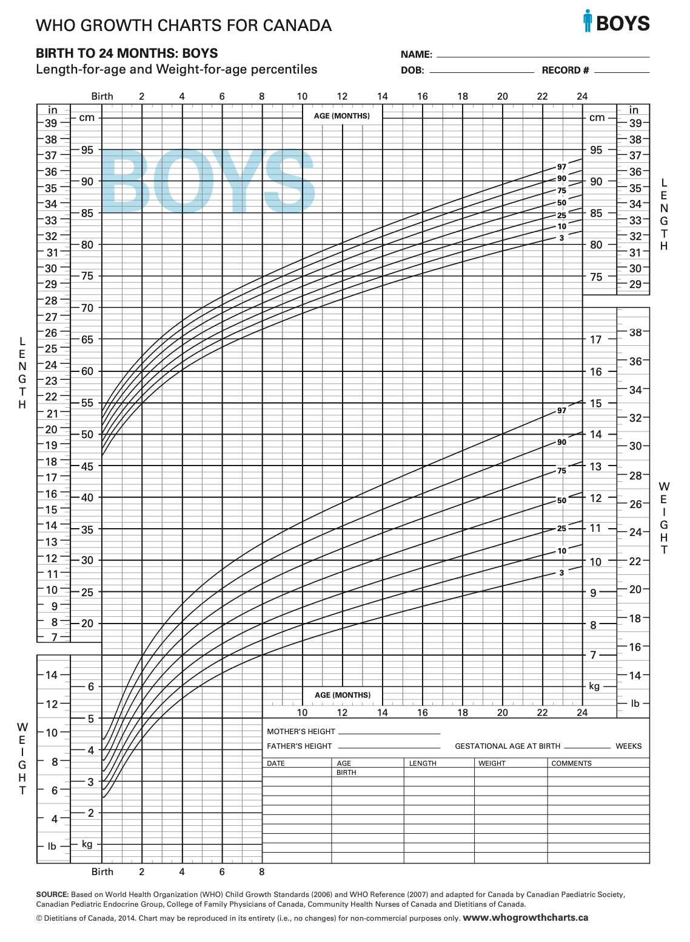
ASIDE
Finding the percent ideal body weight
Ideal body weight:
Plot measured length/height on growth chart
Determine the length-for-age percentile
Find the same percentile on the weight-for-age and sex growth chart. This is the ideal body weight
% Ideal body weight = actual weight x100
ideal body weight

Slide 12
Which of the following Does NOT Represent FTT?
A 6-month-old infant with normal birth parameters whose weight is now below the 3rd percentile
A 9-month-old girl whose weight was at the 50th percentile and is now at the 10th percentile
A 20-month-old boy whose weight is 70% of ideal body weight for age
An 18-month-old girl whose weight and height have been 5th percentile since birth
A breastfed infant that does not gain weight from 6 to 10 months with introduction of solids

Slide 13
Which of the following Does NOT Represent FTT?
A 6-month-old infant with normal birth parameters whose weight is now below the 3rd percentile
A 9-month-old girl whose weight was at the 50th percentile and is now at the 10th percentile
A 20-month-old boy whose weight is 70% of ideal body weight for age
An 18-month-old girl whose weight and height have been 5th percentile since birth
A breastfed infant that does not gain weight from 6 to 10 months with introduction of solids
Notes:
Children’s weight and height typically (but not always) follow given percentile from birth to adulthood
During the first 2-3Y of life, not uncommon to see a child’s growth deviate from its previous percentile either upward or downward (to adjust toward their genetic potential (catch down growth for LGA and catch up growth for SGA), but this must be closely monitored because it can indicate an underlying health problem

Slide 14
Normal Growth
Normal Growth
Healthy infant:
Loses 5-10% of birth weight (BW) in first week of life
Regains BW by 10-14 days of life
Doubles BW by 6 months
Triples BW by 1 year
Breastfed infants gain weight at a faster rate than formula fed infants in first several months
Average caloric requirements for first 12 months is 100 kcal/kg/d
Notes:
Brief postnatal weight loss because of normal extracellular volume loss

Slide 15
Which of the following regarding pediatric growth measurements is fALSE?
A premature infant’s weight should be plotted according to “corrected age” until 1 year of age
Infants’ length should be measured on a recumbent until 2 years, then standing
Children’s growth parameters should be measured at every visit
Head circumference should be plotted routinely until 3 years of age and thereafter if concerns
Average weight gain for a 0-3 month-old infant is 30 g/day

Slide 16
Which of the following regarding pediatric growth measurements is fALSE?
A premature infant’s weight should be plotted according to “corrected age” until 1 year of age
Infants’ length should be measured on a recumbent until 2 years, then standing
Children’s growth parameters should be measured at every visit
Head circumference should be plotted routinely until 3 years of age and thereafter if concerns
Average weight gain for a 0-3 month-old infant is 30 g/day
Corrected age = chronological age – weeks of prematurity
e.g. 28wk premature infant who is 40wks old chronologically has a corrected age of 12 wks old
Use until 2 years of age
Notes:
Chronological vs corrected age
Corrected age = chronological age – weeks of prematurity

Slide 17
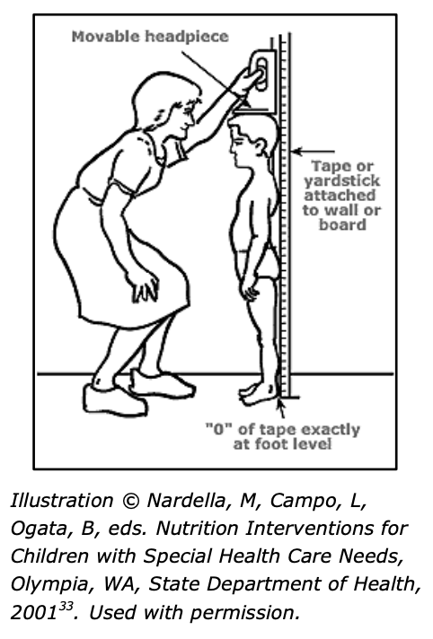
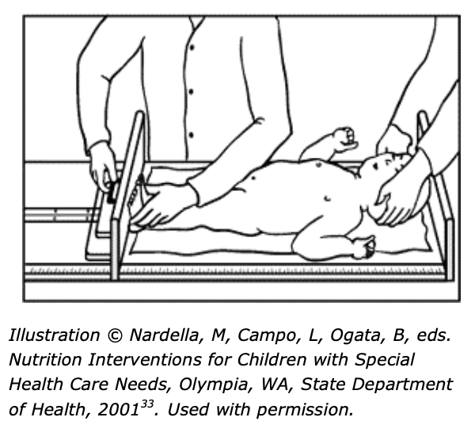
Recumbent
Birth to 2-3yo
Stadiometer
2yo or older

Slide 18
Objectives
Define “failure to thrive” (FTT).
Discuss the differential diagnosis for FTT in children.
Outline an appropriate history in a child with FTT.
Recognize the role of the multidisciplinary team in the management of FTT in children.

Slide 19
Classification
Historical classification:
Organic – medical issues
Non-organic – psychosocial and environmental factors
Current understanding:
Multi-factorial continuum

Slide 20
Differential diagnosis
Inadequate caloric intake
Inadequate nutrient absorption
Excess metabolic demand
Defective utilization of nutrients

Slide 21
1. Inadequate Intake
Not enough food offered
Food insecurity
Difficult caregiver/child relationship
Inappropriate feeding technique
Neglect
Poor dietary intake (excessive fruit juice, restricted diet, inappropriate foods or serving sizes for age)
Child not taking enough food
Low appetite: cerebral palsy, genetic syndromes, chronic constipation
Behavioural problems affecting intake (e.g. Autism)
Anatomical/mechanical problems: cleft palate, dental caries, adenoidal hypertrophy
Emesis
Increased ICP, adrenal insufficiency, medications
Notes:
Food insecurity can be defined as the limited or uncertain ability to obtain nutritionally adequate and safe foods in a socially acceptable manner.
Parents often decrease food expenditures by the same amount that they have to increase energy expenditures during colder months; for families who already experience food insecurity, further diverting money away from food purchases could potentially lead to undernutrition in children.
Excess cow milk consumption has been associated with lower intake of food, although not poor weight gain, and with iron deficiency anemia that can be severe.
Iron and micronutrient deficiencies often (although not always) accompany poor growth and feeding disorders, and iron and zinc deficiencies suppress appetite.
A review by Marshall et al (64) found that common characteristics of feeding difficulties among children with Autism include restricted dietary variety or limited diet based on texture, food neophobia, and food refusal; both dietary quality and mealtime behaviors were common problems.

Slide 22
2. Inadequate Nutrient Absorption
Malabsorption
Pancreatic disease: cystic fibrosis, Shwachman-Diamond syndrome
Cholestatic liver disease: biliary atresia, cirrhosis
Intestinal disease: celiac, IBD, NEC, short bowel syndrome, GI obstruction (pyloric stenosis, malrotation, intussusception)
Food sensitivity or intolerance: CMPI, lactose intolerance, gluten
Increased losses
Infectious diarrhea
Chronic renal failure (Ca, P, vitamin D)

Slide 23
3. Excessive Metabolic Demand
Malignancy
Chronic systemic infections (e.g. TB, TORCH)
Chronic diseases:
Cardiac (e.g. heart failure)
Renal (e.g. chronic renal failure, renal tubular acidosis)
Respiratory (e.g. cystic fibrosis, bronchopulmonary dysplasia, interstitial lung disease)
Endocrine (e.g. hypo/hyperthyroidism, growth hormone deficiency)
Autoimmune (e.g. juvenile idiopathic arthritis)

Slide 24
4. Defective utilization of nutrients
Inborn errors of metabolism (e.g. galactosemia, methylmalonic acidemia)
Storage disease (e.g. glycogen storage disease)

Slide 25
General Growth Patterns
Weight | Height | Head Circumference | Conditions
 | N | N | Inadequate intake Inadequate absorption Increased demand Impaired utilization
 |  | N | Constitutional growth delay Endocrinopathy
 |  |  | Genetic conditions Metabolic conditions Congenital/perinatal insult
Notes:
Deceleration in head circumference is a late sign of severe malnutrition in children younger than 2 years or is an indication of a possible syndromic condition.
Adjustment toward genetic potential usually affects weight and height similarly

Slide 26
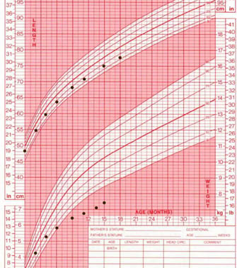
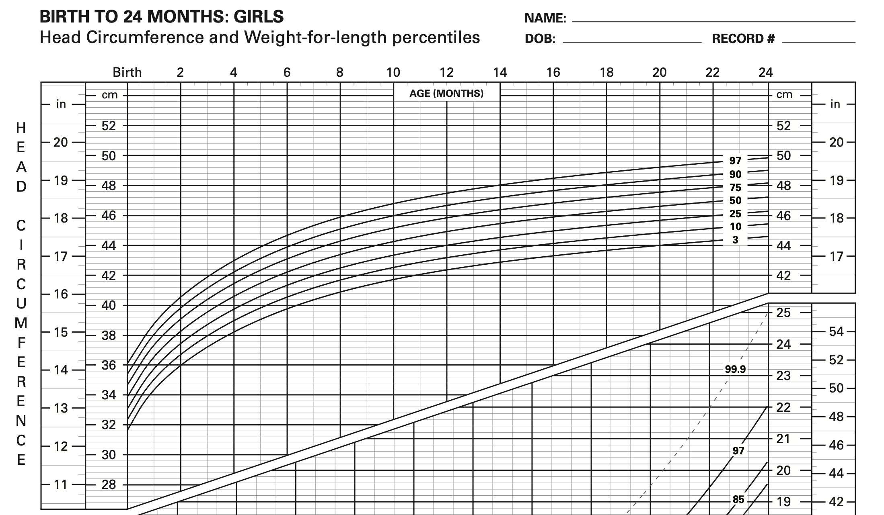
Which Growth pattern is represented?
Constitutional growth delay
Genetic condition
Endocrine abnormality (e.g. growth hormone deficiency)
Malnutrition
Notes:
Only weight affected
Malnutrition

Slide 27
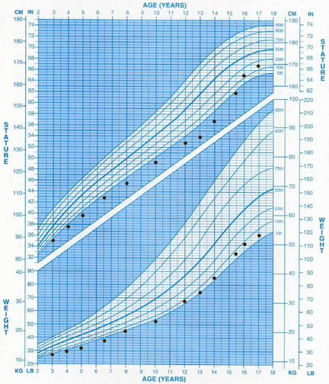
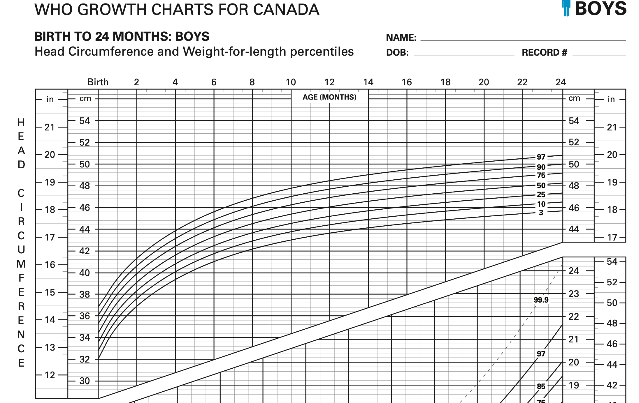
Which Growth pattern is represented?
Constitutional growth delay
Genetic condition
Endocrine abnormality (e.g. growth hormone deficiency)
Malnutrition
Notes:
Wt and height is affected, but increased height at the end
HC proportional
Constitutional growth delay

Slide 28
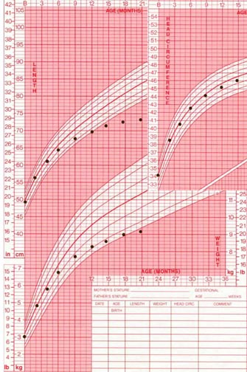
Which Growth pattern is represented?
Constitutional growth delay
Genetic condition
Endocrine abnormality (e.g. growth hormone deficiency)
Malnutrition
Notes:
Weight and height affected
Normal HC
Endocrine abnormality

Slide 29
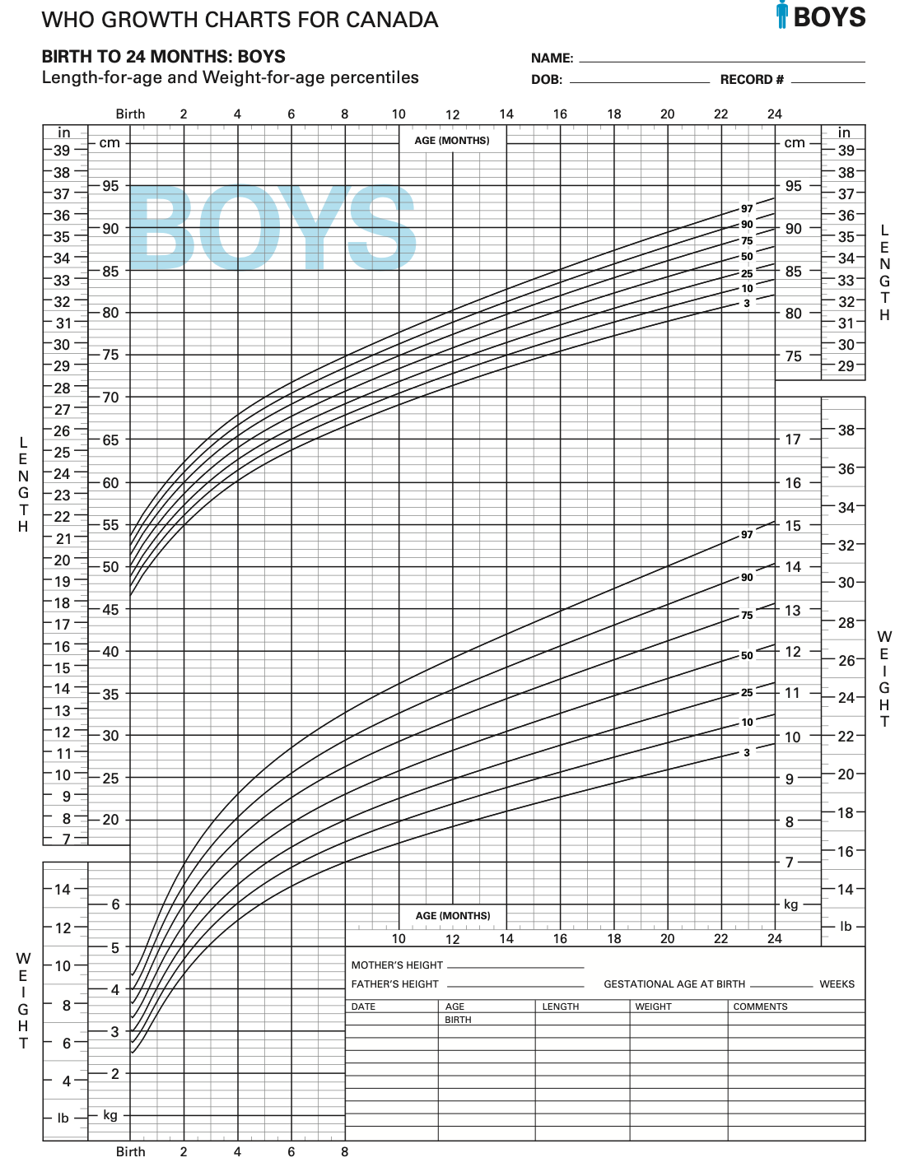
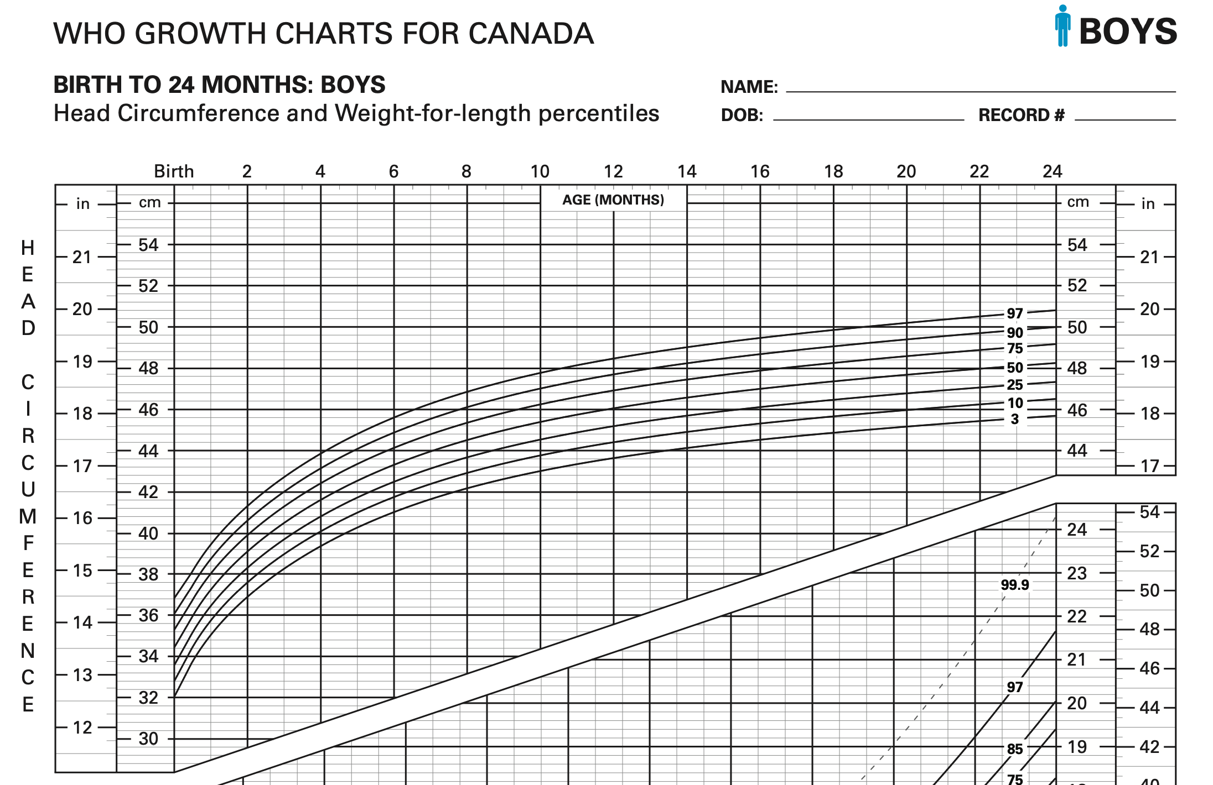
Which Growth pattern is represented?
Constitutional growth delay
Genetic condition
Endocrine abnormality (e.g. growth hormone deficiency)
Malnutrition
d
Notes:
Ht, wt, and HC affected
Genetic condition

Slide 30
Objectives
Define “failure to thrive” (FTT).
Discuss the differential diagnosis for FTT in children.
Outline an appropriate history in a child with FTT.
Recognize the role of the multidisciplinary team in the management of FTT in children.

Slide 31
Case: Alex Petit
14 month old girl
First child to parents
Born at term with BW 3.5kg
Breastfed exclusively for 6 months, formula until 1 year, then cow’s milk
Started solids at 8 months
Now drinks 5 bottles a day of milk, only likes to eat pasta, applesauce, and cookies
Eats dinner with babysitter in front of TV
Notes:
What’s concerning?
- relationship with caregiver
- intake: restricted diet, excessive milk
- Delayed to starting solids

Slide 32
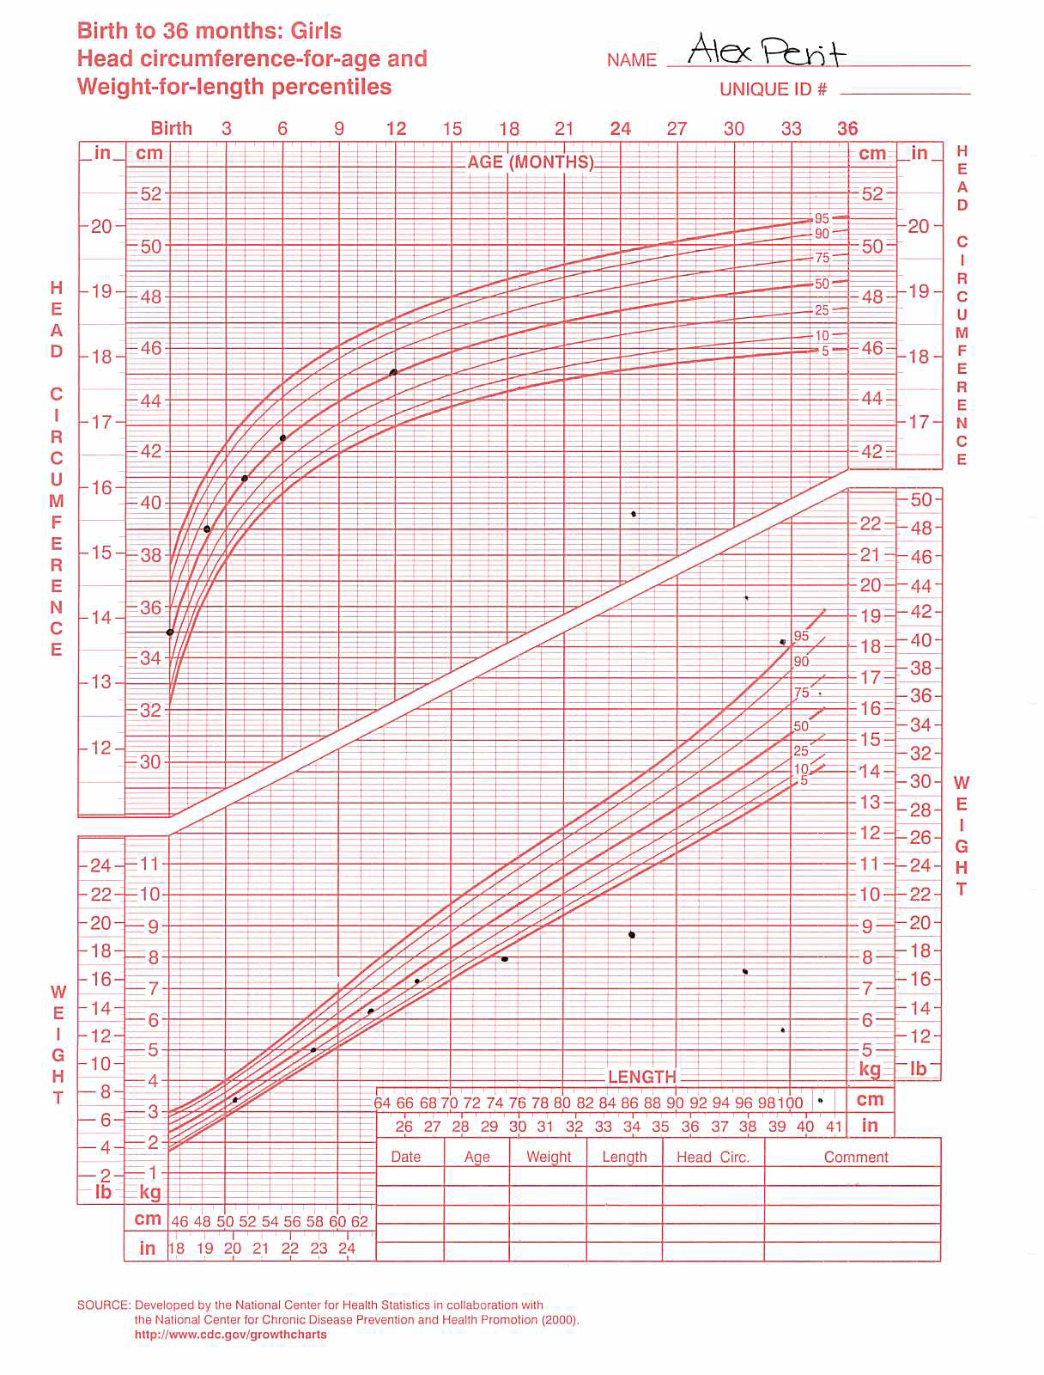
Notes:
Wt affected
Normal height and HC
Intake issue

Slide 33
What other information would you like to know?

Slide 34
Dietary History
What does the child eat?
Breastfeeding, formula, solids
Quantity
Types of food
3 day food diary helpful
When does the child eat?
Frequency and duration of meals
Where does the child eat?
Distractions
Environment (positioning, caregivers)
Notes:
Breastfeeding – frequency, length of time, good suck, let-down, hear swallowing, tiring with feeds
Formula – mixing
Solids – introduction (4-6mo with iron rich foods), texture problems, choking/gagging
Types of food – restrictive diets

Slide 35
Feeding Behaviours
How does the caregiver know child is hungry (i.e. cues)?
How does the caregiver react when child eats well/poorly?
Does the child refuse food?
Does the child feed differently with different people?
Do the caregiver and child have struggles over feeding?
Are there any cultural beliefs and practices?
Notes:
Cultural variations in feeding practices influence which foods are offered and when they are introduced in an infant/ toddler's diet.
Cultural beliefs and practices influence how parents and caregivers perceive their children’s weight, and this perception may influence the family’s response to dietary recommendations given by health providers
It is important to acknowledge that most traditional non-Western diets (assuming that a variety of foods is available) promote health better than the typical Western diet, which is high in saturated fat, sugars, and meat and deficient in fruits, vegetables, and whole grains. The goal is not to convert parents from other cultures to a Western diet but to help them adapt their traditional practices and available and preferred foods to meet the child’s current nutritional needs.

Slide 36
History
Pregnancy and Birth History
Pre-natal exposures: maternal infection, meds, alcohol
IUGR, gestational age, perinatal stress, birthweight
Past Medical History
Chronic diseases may affect intake, absorption, energy needs
Developmental History
Developmental and behavioural problems can play a significant role in FTT
Notes:
Chronic diseases or developmental and behavioural problems that can affect intake, absorption, energy needs
SGA (<10th percentile for gestational age), or large for gestational age (>90th percentile for gestational age)

Slide 37
History
Very detailed thorough Review of Systems is critical
Particularly inquiring re: signs or symptoms of a medical condition
E.g.
Vomiting
Stooling habits
Sleep
Fevers
Rash

Slide 38
Family History
Weight and height of family members (parents and siblings)
History of developmental delay or genetic conditions
Illnesses that contribute to poor growth

Slide 39
Psychosocial History
Psychosocial stressors are a leading cause of insufficient nutrient intake in children
E.g. poverty, parental depression, family discord, substance use
Ask about:
Family composition and who lives at home
Employment status
Parental education/knowledge of appropriate diet
Degree of social isolation/supports
Family stress
Abuse

Slide 40
What Else would you like to do?

Slide 41
Physical Exam
Identification of cause and effects
Looking for:
Signs of underlying disease that may be impairing growth
Severity of growth failure and effects of malnutrition
Dysmorphic features suggestive of genetic disorder
Signs of possible abuse or neglect - DUTY TO REPORT
Think of weight, height, head circumference as vital signs!
Notes:
Optimally, children should be weighed in the same conditions (eg, undressed, no diaper), on the same scale

Slide 42
Physical Exam
Physical Exam Clues | Potential Significance
Tachypnea/tachycardia?
Hypertension?
Pallor?
Edema?
Microcephaly?
Cardiac murmur?
Abdominal distention?
Clubbing?
Cheilosis?

Slide 43
Physical Exam Clues | Potential Significance
Tachypnea/tachycardia? | Increased metabolic demands
Hypertension?
Pallor?
Edema?
Microcephaly?
Cardiac murmur?
Abdominal distention?
Clubbing?
Cheilosis?

Slide 44
Physical Exam Clues | Potential Significance
Tachypnea/tachycardia? | Increased metabolic demands
Hypertension? | Renal disease
Pallor?
Edema?
Microcephaly?
Cardiac murmur?
Abdominal distention?
Clubbing?
Cheilosis?

Slide 45
Physical Exam Clues | Potential Significance
Tachypnea/tachycardia? | Increased metabolic demands
Hypertension? | Renal disease
Pallor? | Anemia
Edema?
Microcephaly?
Cardiac murmur?
Abdominal distention?
Clubbing?
Cheilosis?

Slide 46
Physical Exam Clues | Potential Significance
Tachypnea/tachycardia? | Increased metabolic demands
Hypertension? | Renal disease
Pallor? | Anemia
Edema? | Protein deficiency Renal disease
Microcephaly?
Cardiac murmur?
Abdominal distention?
Clubbing?
Cheilosis?
Notes:
Split up anemia and protein deficiency

Slide 47
Physical Exam Clues | Potential Significance
Tachypnea/tachycardia? | Increased metabolic demands
Hypertension? | Renal disease
Pallor? | Anemia
Edema? | Protein deficiency Renal disease
Microcephaly? | Neurologic disorder Fetal alcohol syndrome Congenital infection Genetic syndrome
Cardiac murmur?
Abdominal distention?
Clubbing?
Cheilosis?

Slide 48
Physical Exam Clues | Potential Significance
Tachypnea/tachycardia? | Increased metabolic demands
Hypertension? | Renal disease
Pallor? | Anemia
Edema? | Protein deficiency Renal disease
Microcephaly? | Neurologic disorder Fetal alcohol syndrome Congenital infection Genetic syndrome
Cardiac murmur? | Congenital heart disease
Abdominal distention?
Clubbing?
Cheilosis?

Slide 49
Physical Exam Clues | Potential Significance
Tachypnea/tachycardia? | Increased metabolic demands
Hypertension? | Renal disease
Pallor? | Anemia
Edema? | Protein deficiency Renal disease
Microcephaly? | Neurologic disorder Fetal alcohol syndrome Congenital infection Genetic syndrome
Cardiac murmur? | Congenital heart disease
Abdominal distention? | Malabsorption
Clubbing?
Cheilosis?

Slide 50
Physical Exam Clues | Potential Significance
Tachypnea/tachycardia? | Increased metabolic demands
Hypertension? | Renal disease
Pallor? | Anemia
Edema? | Protein deficiency Renal disease
Microcephaly? | Neurologic disorder Fetal alcohol syndrome Congenital infection Genetic syndrome
Cardiac murmur? | Congenital heart disease
Abdominal distention? | Malabsorption
Clubbing? | Chronic hypoxia related to cardiac, pulmonary, or liver disorder
Cheilosis?

Slide 51
Physical Exam Clues | Potential Significance
Tachypnea/tachycardia? | Increased metabolic demands
Hypertension? | Renal disease
Pallor? | Anemia
Edema? | Protein deficiency Renal disease
Microcephaly? | Neurologic disorder Fetal alcohol syndrome Congenital infection Genetic syndrome
Cardiac murmur? | Congenital heart disease
Abdominal distention? | Malabsorption
Clubbing? | Chronic hypoxia related to cardiac, pulmonary, or liver disorder
Cheilosis? | Vitamin deficiency

Slide 52
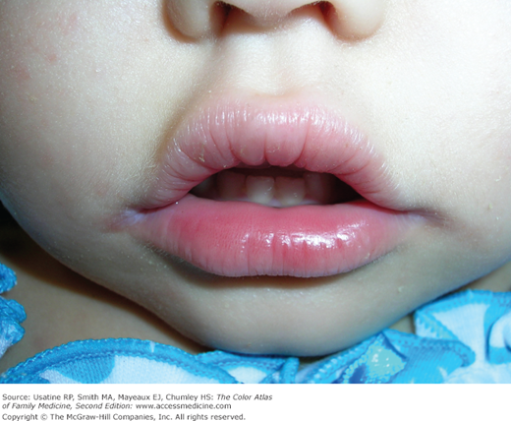
Cheilosis

Slide 53
Which of the following is Incorrect?
It is important to observe the parent-child interaction during a consult for FTT
The physical examination is often normal with an infant with FTT
Laboratory investigations are always critical to identify a cause for FTT
It is rare for a child with FTT to require hospitalization
Psychosocial stressors are the main cause of insufficient nutrient intake in children of all ages
Notes:
Physical exam (not including the weight)

Slide 54
Which of the following is Incorrect?
It is important to observe the parent-child interaction during a consult for FTT
The physical examination is often normal with an infant with FTT
Laboratory investigations are always critical to identify a cause for FTT
It is rare for a child with FTT to require hospitalization
Psychosocial stressors are the main cause of insufficient nutrient intake in children of all ages

Slide 55
Investigations
Guided by careful history and physical examination
Laboratory tests unlikely to reveal organic cause in absence of suggestive evidence on history or physical
Basic: CBC+diff, lytes, gas, BUN, Cr, glucose, calcium, magnesium, phosphorus, albumin, total protein, iron studies, liver enzymes, TSH, serum immunoglobulins, TTG IgA and total IgA, urinalysis and culture
Further: sweat chloride test, vitamin levels, stool culture, fecal elastase, zinc, lead, TB skin test, HIV serology, GI imaging, bone age
Notes:
Judicious use of investigations
<1% of investigations useful for FTT work-up

Slide 56
Investigations
Most important to have a rationale for what you are ordering
For example:
Test | Rationale
CBC+diff | Anemia, malignancy
Lytes, extended lytes, gas, Cr, BUN | Renal tubular acidosis, monitor refeeding syndrome
Iron studies | Iron deficiency
TTG IgA and total IgA | Celiac disease (only test in children old enough to have been introduced to gluten)
Urine tests | Infection, glycosuria, renal pathology
Stool studies | Infection, malabsorpion
Notes:
Food introduced quickly aftera. Period of malnourishment with shifts of electrolytes that can cause serious complications. Hypophos, hypoMg, HypoK
During starvation, glucagon increases and insulin decreases
Leads to rapid conversion of glycogen stores to form glucose as well as gluconeogenesis (glucose synthesis via lipid and protein breakdown). Catabolism of adipose tissue and muscle, loss of lean body mass
Ketone bodies and free fatty acids replace glucose as major energy source.
During refeeding, shift from fat to carb metabolism. Glucose load leads to insulin, which causes increased cellular uptake of glucose, phosphate, K, Mg, water, and protein synthesis

Slide 57
Objectives
Define “failure to thrive” (FTT).
Discuss the differential diagnosis for FTT in children.
Outline an appropriate history in a child with FTT.
Recognize the role of the multidisciplinary team in the management of FTT in children.

Slide 58
Management
Primary goal of management of FTT is to improve nutritional status
Identify the underlying cause and treat
Nutritional intervention
Additional calories for catch-up growth
Increase caloric density (e.g. fortification; add oils, heavy cream, peanut butter)
Limit “empty” calories (e.g. juice)
Support parents
Close follow up critical
Notes:
TTotal intake takes into account requirements for age and the need for supplemental calories to ensure catch-up growth.
Caloric needs (cal/kg/d) = caloric needs for weight age (cal/kg/d) × ideal weight for height (kg) / Actual weight (kg)

Slide 59
Behaviour modification
Parental reassurance (reduce anxiety)
Structured mealtimes that are relaxed and social
Reduce mealtime distractions
Give children opportunity to feed themselves and make some choices
Offer solids before liquids
Praise child for positive behaviours
Parents’ role is to provide the food, child’s role is to decide whether to eat and how much
Notes:
Health care professionals must be aware of the impact that their words and actions will have on families. Avoid blaming
Interventions should aim at reducing parental anxiety, returning the control of feeding to the child, and making mealtimes more enjoyable and positive family experiences
parents are tasked with providing the food (or breast or bottle in the case of infants) and the child is responsible for whether to eat and how much

Slide 60
Multidisciplinary approach
May need:
Dietician
Occupational therapists and/or speech language pathologists
Social work
Psychologist
Notes:
Early referral for multidisciplinary support can help reduce the severity of malnutrition and feeding difficulties and of caregiver stress and long-term developmental and educational impairments.

Slide 61
Hospitalization
Rarely required
Indications
Failed outpatient management
Concern for child’s well-being or safety
Severe malnutrition (risk of refeeding syndrome)
Precise documentation of intake
Close observation of parent-child interaction
Initiation of nasogastric feeds
Serious underlying illness or medical problem

Slide 62
Pharmacologic Intervention
Vitamin/mineral supplements if deficient
Only in exceptional cases for children with growth failure due to inadequate dietary intake with expert consultation
Appetite stimulants
Cyproheptadine
Cannabinoid derivatives and megestrol acetate should not be givien to healthy children
Notes:
Can help modify child’s behaviour toward food so they’re hungrier and happier to eat. Reduces parental anxiety and makes mealtimes less stressful
Cyproheptadine
- relatively safe and effective in the short-term (not studied long-term) even in young children for increasing oral intake, accelerating weight gain, and improving mealtime behavior.
- Antiserotoninergic and antihistaminergic
- Can cause transient drowsiness. less common adverse effects of excitation or other behavioral changes
- Tolerance develops over time, and it is necessary to cycle its use to maintain efficacy
Megestrol acetate (megase) is synthetic progesterone. Used for breast and uterine cancers.

Slide 63
Tube Feedings
Only in exceptional cases
Can be traumatic for both child and family. Can increase oral aversion and decrease appetite
Some indications:
Underlying disease is worsened by poor nutritional status, which can worsen outcomes
Oral intake is unsafe

Slide 64
Back to the Case – ALEX Petit
Physical examination normal
CBC showed Hgb of 90 (anemic) MCV 68 (microcytic) and ferritin of 3 (low)
What are your suggestions for management of Alex’s case?
Notes:
Maybe a little pallor

Slide 65
Back to the case – ALEX PETIT
Iron supplements
Introduce new foods with meals with some old favourites
Decrease milk intake
Encourage high calorie foods
Give 3 meals a day with snacks in between
Turn off the TV/screens
Eat with company in a high chair
Follow up in 2 months
Notes:
Wait until your baby is 9-12 months old before introducing whole cow’s milk. Limit to 720 mL (24oz) after 12 months of age

Slide 66
FTT Summary
FTT is common and should be identified
Often multifactorial etiology – think about 4 categories
Insufficient intake 3. Increased metabolic demand
Inadequate absorption 4. Deficiency in nutrient utilization
A good history and physical is most important
Empiric investigations are seldom helpful
Treatment based on addressing underlying medical condition, increasing caloric intake, modifying behaviours and providing support to families
A multidisciplinary approach and frequent follow up are necessary
Early identification and intervention are important in improving long-term outcomes

Slide 67
Suggested resources
Marchand V, on behalf of the CPS Nutrition and Gastroenterology Committee. The toddler who is falling off the growth curve. Paediatr Child Health 2012; 17(8):47. https://cps.ca/documents/position/toddler-falling-off-the-growth-chart
Marchand V, on behalf of the CPS Nutrition and Gastroenterology Committee. Promoting optimal monitoring of child growth in Canada: using the new World Health Organization growth charts. Paediatr Child Health 2018. https://cps.ca/documents/position/child-growth-charts
Tang MN, Adolphe S, Rogers SR, Frank DA. Failure to thrive or growth faltering: medical, developmental/behavioral, nutritional, and social dimensions. Peds in Review 2021;42(11):590.

Slide 68

Questions?
eouyang@cheo.on.ca

